Slide 1
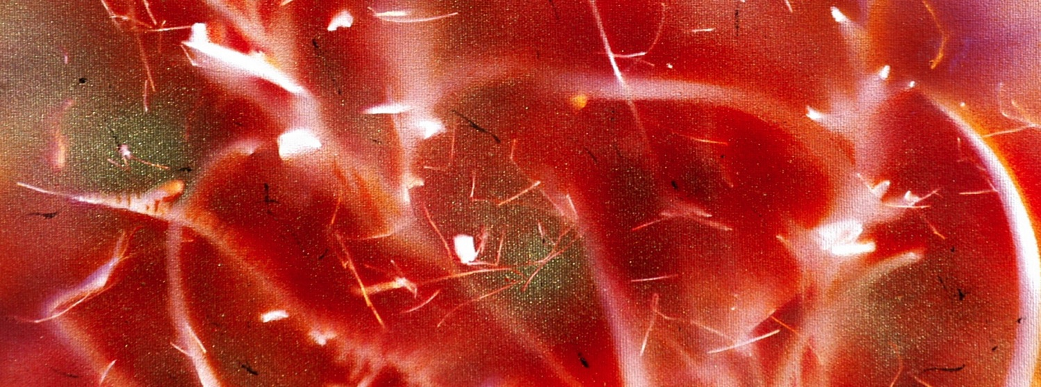
Determining the Absolute Configuration of the α-Carbon in JNJ-A (a GPR40 Superagonist) by NMR Spectroscopy
2019 Eastern Analytical Symposium & Exposition: NMR Spectroscopy Instrumentation and Application
11:10 AM, Nov. 19th, 2019
Ronghui Zhou, Ph.D.
rzhou11@its.jnj.com
Discovery Chemistry, Janssen R&D
Spring House, PA

Slide 2

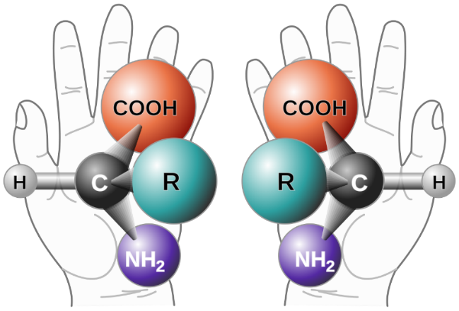
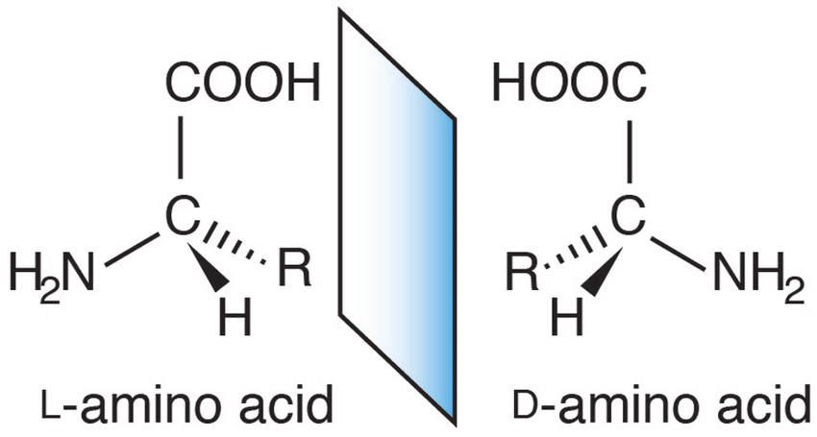
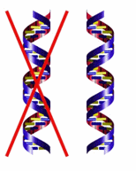
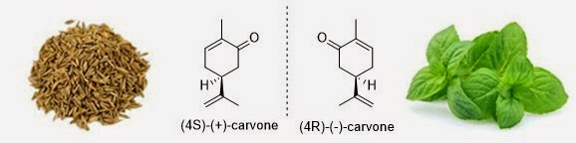
Chirality
Handedness

Slide 3

Chiral Drug: the Thalidomide Tragedy in the 1960s
(R)-thalidomide
(S)-thalidomide
The S enantiomer causes birth defects, while the R enantiomer is effective against morning sickness.
Thousands of children around the world were born with severe birth defects.

Slide 4
Diabetes is a Global Health Crisis

Slide 5
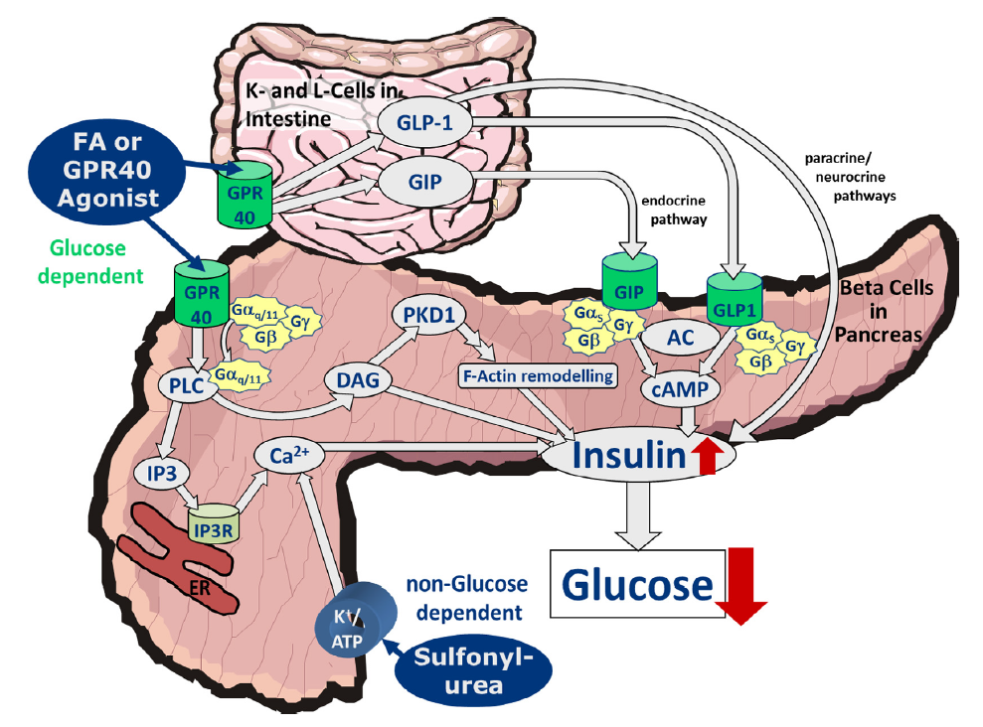
GPR40 Agonism is a Novel Mechanism for T2D
A “nutrient sensor” GPCR on the pancreatic beta cell
Highly expressed in the pancreas, intestine, also human brain
GPR40 activation induces insulin secretion, in a glucose-dependent manner
Expected to lower glucose in patients with T2DM with low risk of hypoglycemia
GPR40 agonist has additional benefit of weight loss
Defossa and Wagner (2014) Bioorganic and Medicinal Chemistry Letters, 24, 2291-3000

Slide 6
GPR40 Agonists: Conformationally Constrained Fatty Acid Mimetics
6

Slide 7
JNJ-A is a GPR40 Superagonist
IPone
JNJ-A
JNJ-0 (full agonist)
JNJ-B (full agonist)
JNJ-C (partial agonist)
JNJ-0
JNJ-A
EC₅₀ –Calcium Mobilization (nM)
(Mean ± SD)
cAMP
Superagonist
 | hGPR40 (n=) | rGPR40 (n=)
JNJ-A | 0.25 ± 0.13 (6) | 0.34 ± 0.18 (6)
JNJ-0 | 0.94 ± 0.37 (10) | 4.1 ± 2.4 (10)
ACS Med. Chem. Lett. 2019, 10, 1, 16-21

Slide 8
The Absolute Configuration of α-carbon in JNJ-A
S
R
S
S
How to determine the absolute configuration of a-carbon: R or S ?

Slide 9
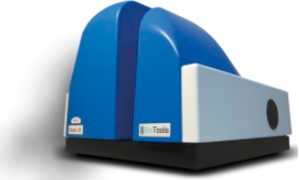
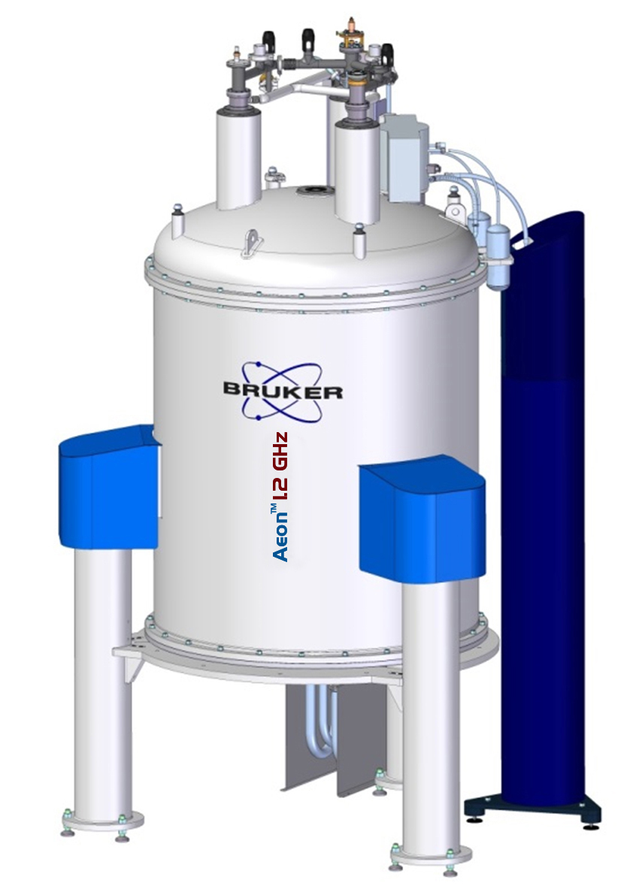
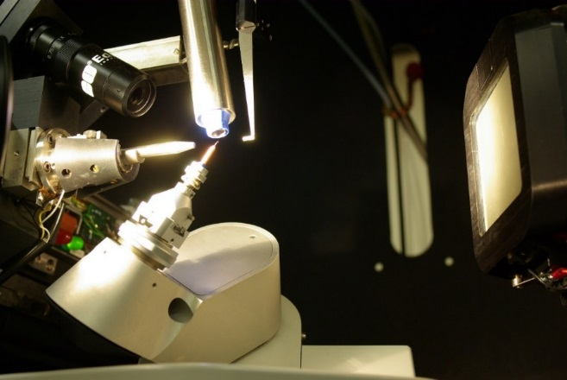
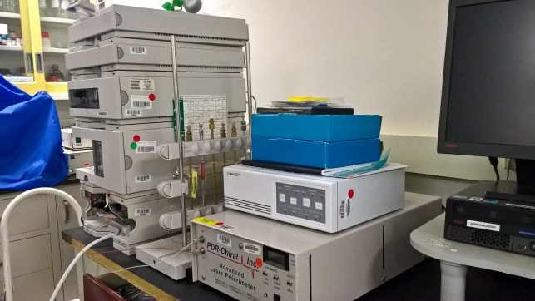
Absolute Configuration: Analytical Techniques
Vibrational
Circular Dichroism
Single-crystal
X-ray Diffraction
NMR
Chiral chromatography

Slide 10
Absolute Configuration: NMR Methods
Chemical Shift
Coupling Constant
Nuclear Overhauser Effect
Computation
Machine Learning
the (R)/(S) notation
Cahn-Ingold-Prelog Rules

Slide 11
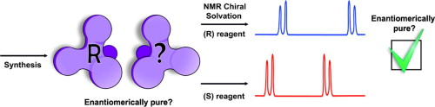
Molecular Structure Feature
Single chiral center or remote chiral centers
With neighboring predefined chiral center
Chiral Auxiliary
Chiral derivatizing agent: Mosher’s acid
Chiral solvating/shift agent
Alignment medium

Slide 12
Molecular Structure Feature
Single chiral center or remote chiral centers
With neighboring predefined chiral center
Scalar Coupling Constant
Nuclear Overhauser Effect
Conformational Analysis

Slide 13
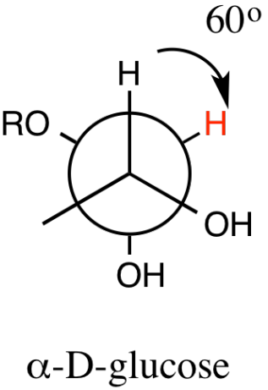
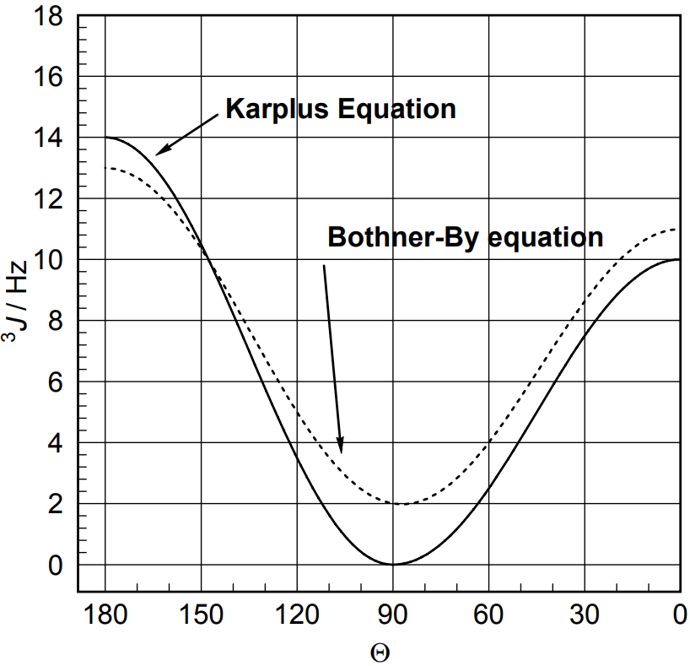
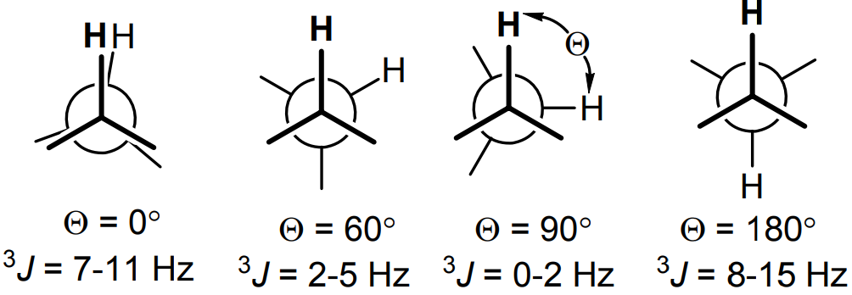
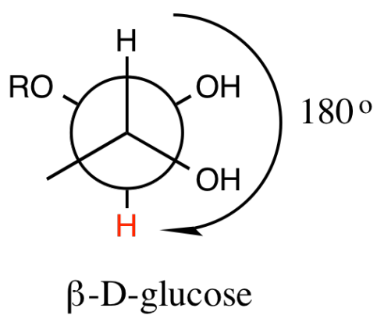
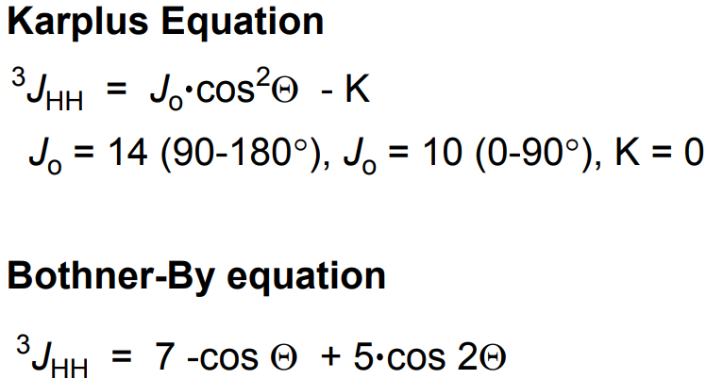
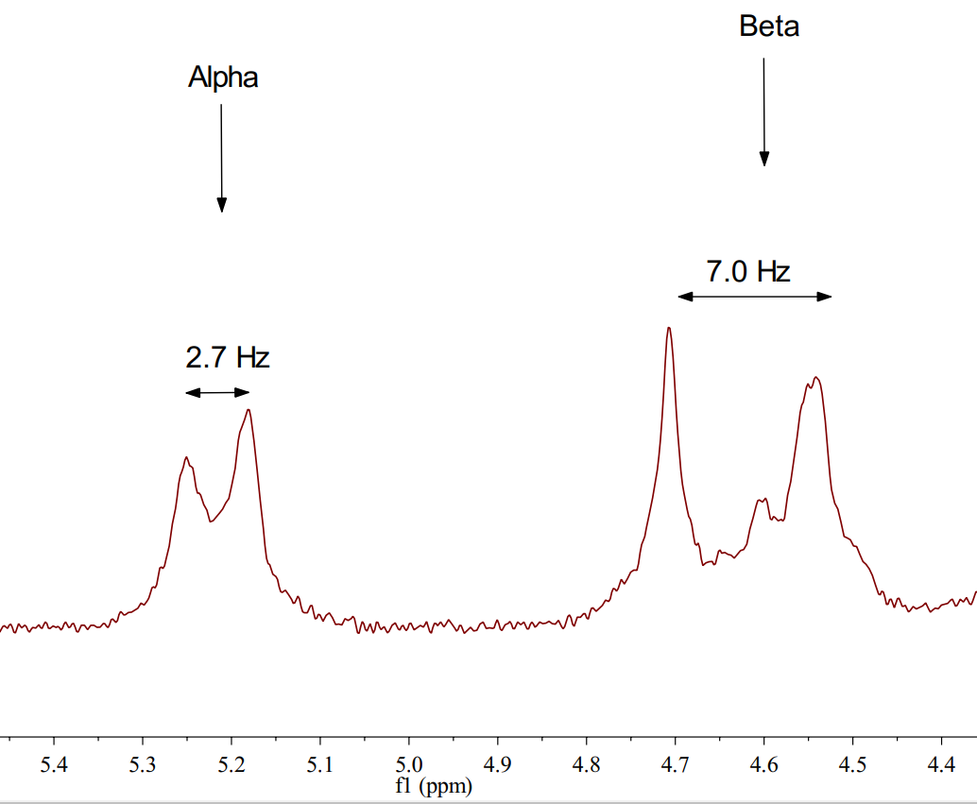
Scalar Coupling Constant & the NOE Effect
Magritek Application Note 5: Glucose Anomers

Slide 14
The Absolute Configuration of the α-carbon in JNJ-A
Acyclic & highly flexible carbon-carbon single bond
S
R
S
S
What can we do to determine the absolute configuration of α-carbon: R or S ?
Chiral Auxiliary: CDA, CSA, Alignment Medium
Conformational Analysis & Relative Stereochemistry

Slide 15
1D ¹H NMR Fully Assigned

Slide 16
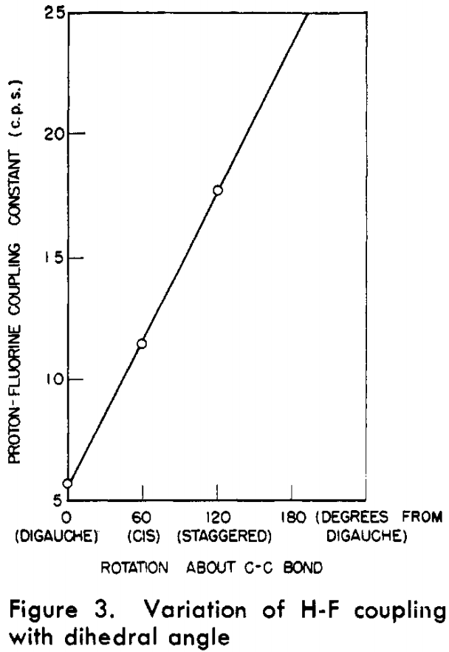
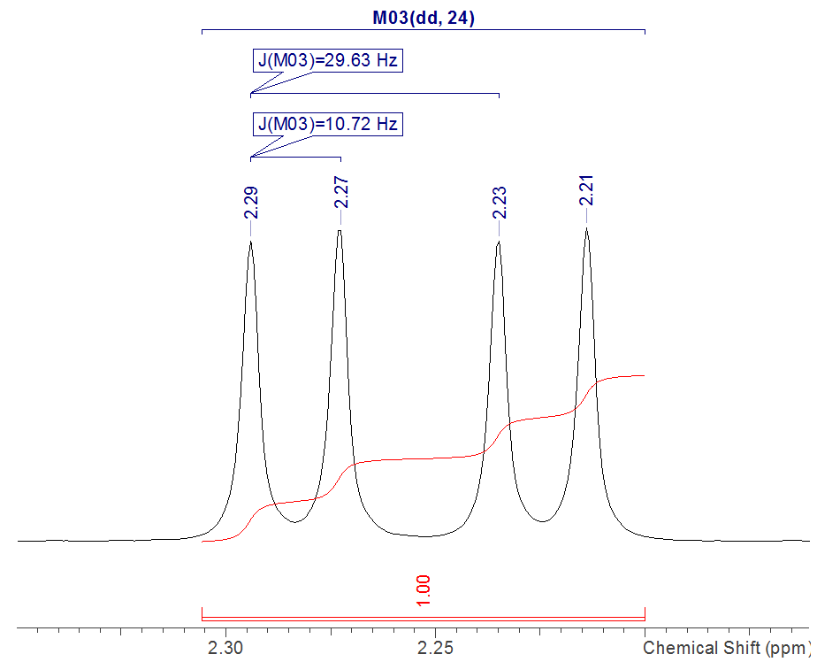
H-F Coupling: Anti-conformer Predominates
Large coupling constant (~30 Hz)
between H₂₄ and F₃₀
Anal. Chem.1965, 37, 3, 403-405

Slide 17
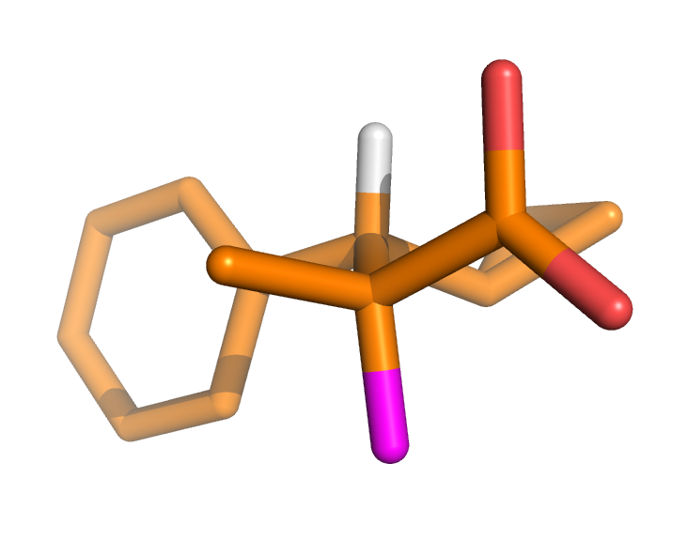
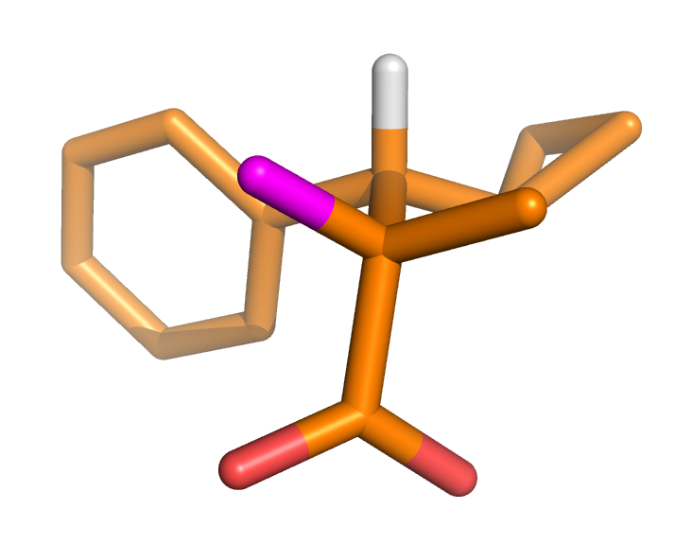
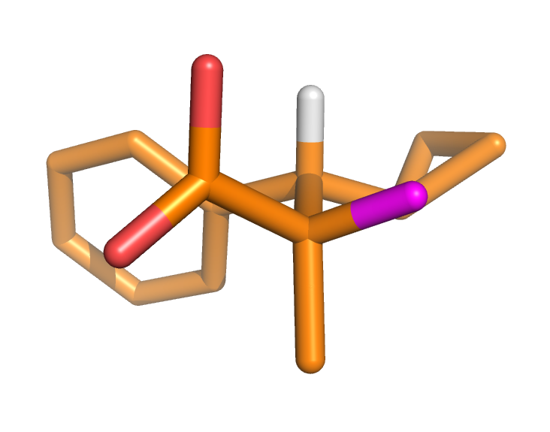
DFT Calculation: Anti-conformer Predominates
93.1%
5.5%
1.3%
H
F
>> >
B3LYP-D3/6-31G** optimization of 20 conformers from OPLS3e conformational search
PCM water

Slide 18
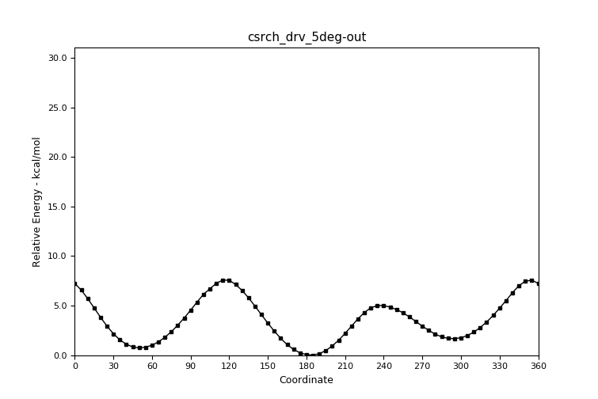
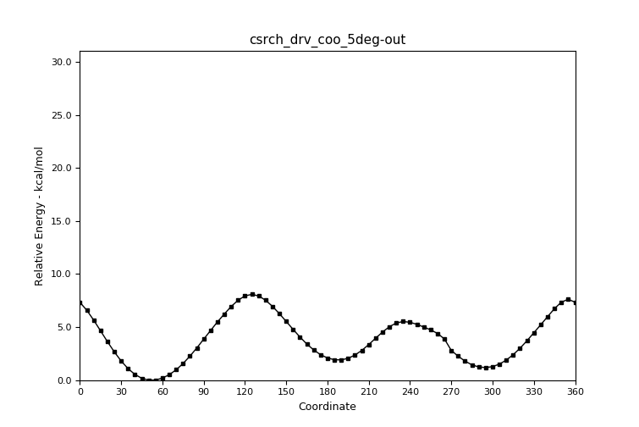
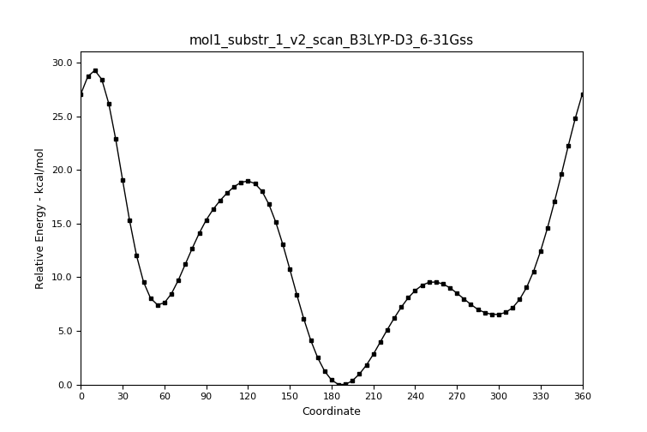
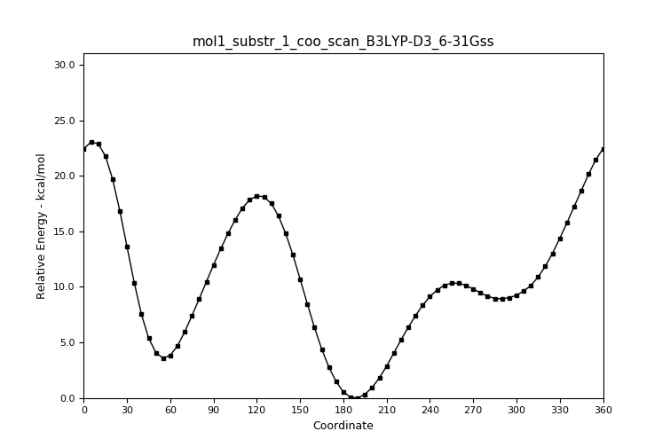
MM/QM Calculation: Torsion/Energy Profiles
OPLS3e
GB/SA water
COOH
COO-
DFT
B3LYP-D3
PCM water
(rigid scan)

Slide 19
Why Anti-conformer: Steric Hindrance?
Relative size (A-value):
S
R
CH₃ ~ COOH >> F
>> >

Slide 20
Steric Hindrance: Energy Barrier?
S
R
75 °C
50 °C
25 °C

Slide 21
The Absolute Configuration of the α-carbon in JNJ-B
S
R
S
S
H instead of CH₃
How to determine the absolute configuration of α-carbon: R or S ?

Slide 22
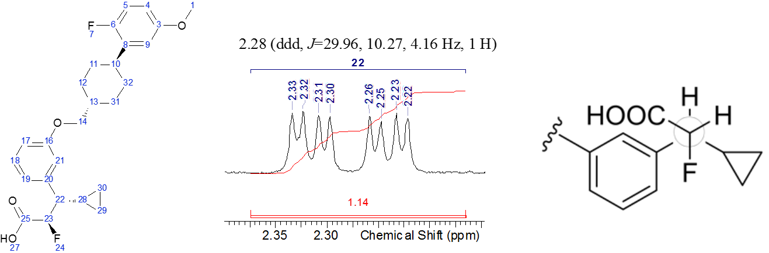
Anti-conformer: beyond Steric Hindrance

Slide 23
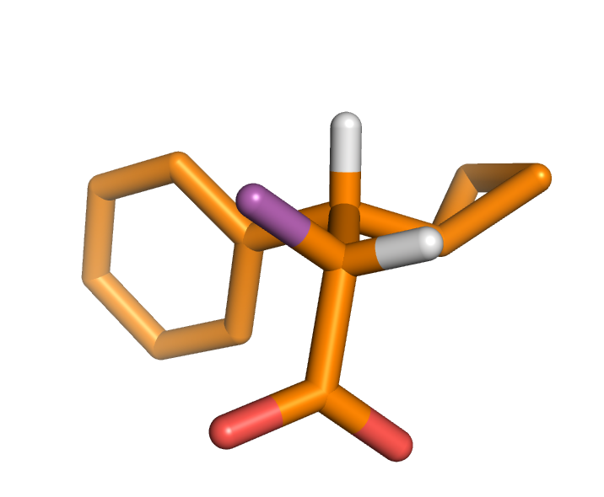
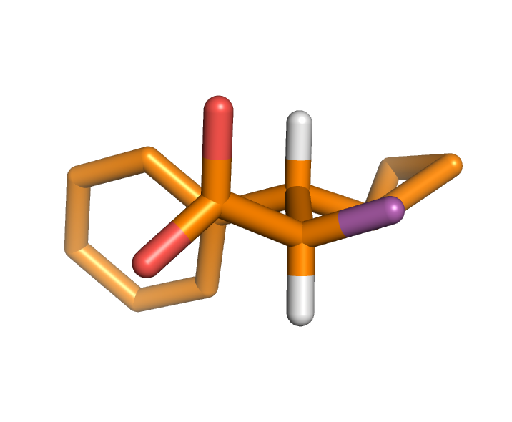
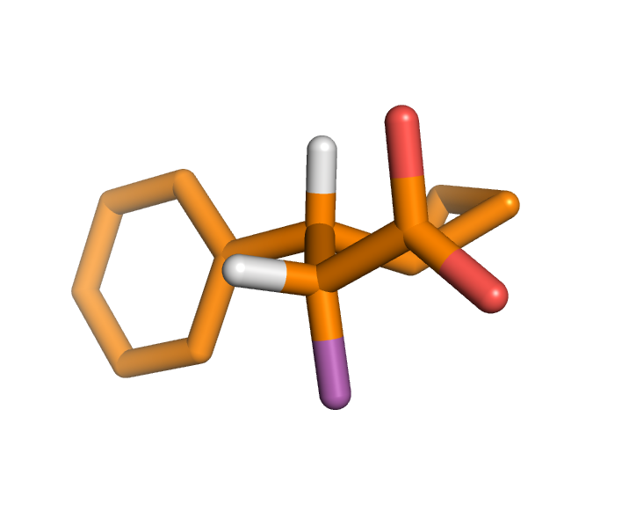
DFT Calculation: Anti-conformer Predominates
91.7%
7.6%
0.5%
H
F
>> >
B3LYP-D3/6-31G** optimization of 13 conformers from OPLS3e conformational search
PCM water

Slide 24
Anti-conformer: beyond Steric Hindrance
Further investigation:
What’s the driving force for the anti-conformer in this case?
What’s the role of carboxylic acid?
>> >

Slide 25
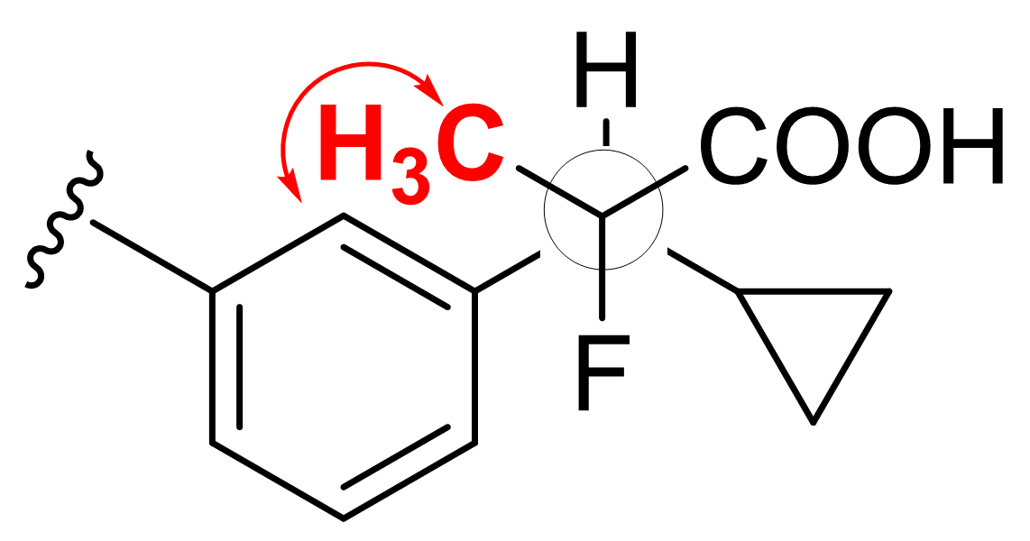
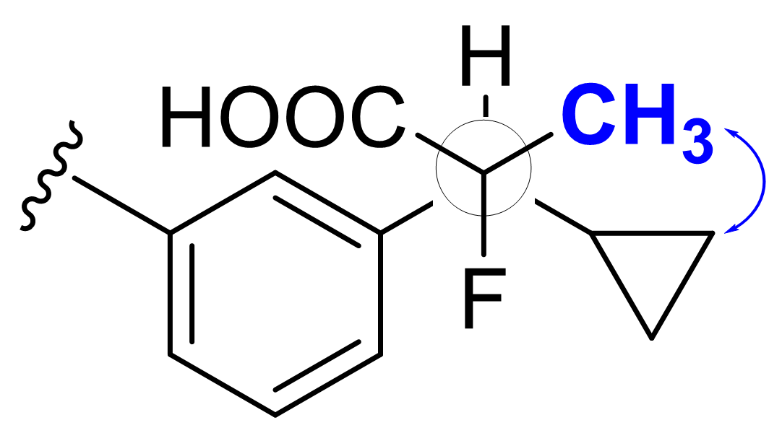
The Nuclear Overhauser Effect: R or S at α-carbon
vs
R-configuration
S-configuration

Slide 26
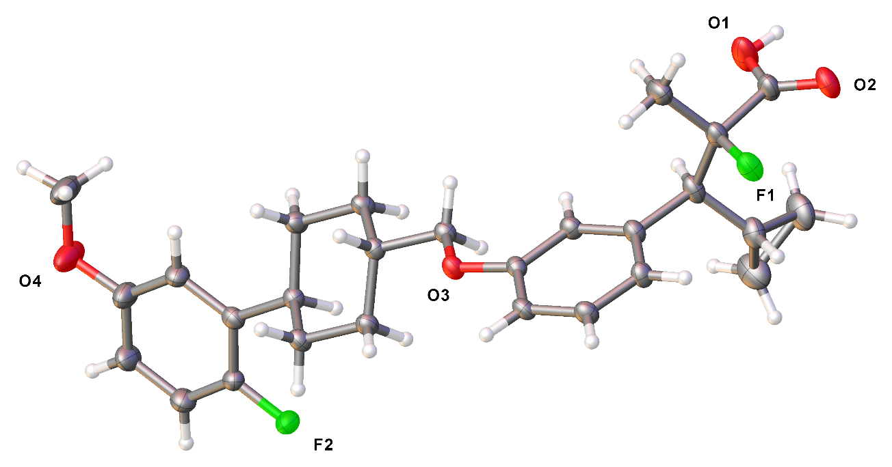
R-configuration Confirmed by XRD
H
R-configuration
XRD Obtained on a Bruker D8 Platinum­¹³⁵ CCD diffractometer equipped with Cu K_{a} radiation (l = 1.5478) at UCSD Crystallography Lab.

Slide 27
Summary
The absolute configuration: NMR consistent with XRD
The steric hindrance around the α- & β-carbons locks the anti-conformation between the β-proton H₂₄ and fluorine
Key information: scalar coupling constant and NOE
MM/QM: energy profile and population distribution
NMR: convenient and reliable alternative to XRD

Slide 28
Acknowledgements
Computational Chemistry
Maxwell D. Cummings, Ph.D.
(mcummin1@its.jnj.com)
Analytical Chemistry
Gregory C. Leo, Ph.D.
A. Kerem Bingol, Ph.D.
John A. Masucci, Ph.D.
Gary W. Caldwell, Ph.D.
Zhicai Shi, Ph.D.
Medicinal Chemistry
Hui Huang, Ph.D.
(hhuang2@its.jnj.com)
Mark R. Player, Ph.D.
James C. Lanter, Ph.D.
Sanath K. Meegalla, Ph.D.
Michael P. Winters, Ph.D.
Discovery Chemistry, Discovery Sciences Discovery, Product Development & Supply Janssen Research & Development Spring House, PA

